Slide 1
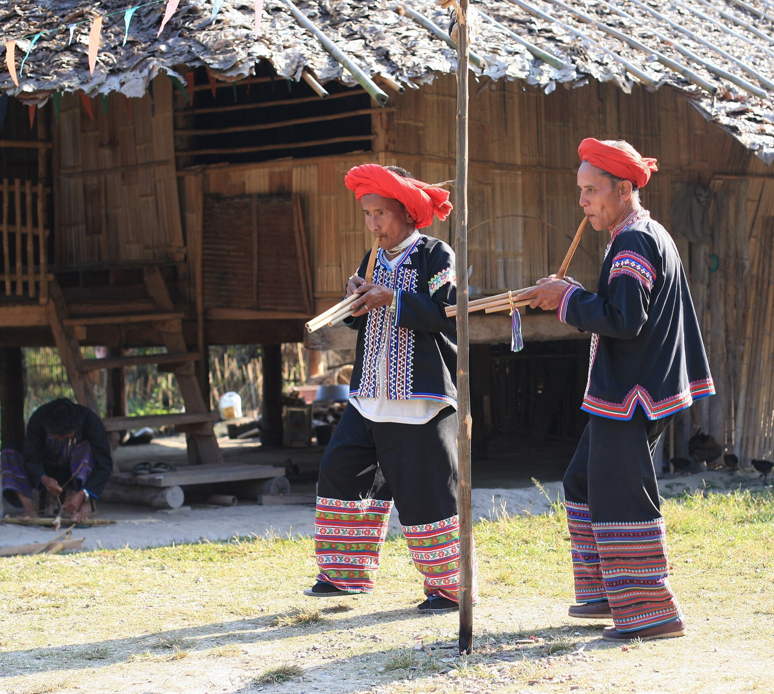
CULTURAL CROSSROADS ASIA FOUNDATION · CHIANG MAI
Board brief, 12 November 2026
สรุปสำหรับคณะกรรมการ 12 พฤศจิกายน 2569
Three decisions today. From Hongdam: NaN and Michael. Fifteen minutes, then questions.
English and Thai. The interactive version: hongdam.net/for/cca/board/
Two Lahu men play pan flutes, Thailand · Steve Jurvetson · CC BY 2.0
Notes:
Welcome. This is Hongdam's brief for the board: three decisions today, fifteen minutes, then your questions. Everything here is also on hongdam.net/for/cca/, in English and Thai.

Slide 2
Three decisions today
สามข้อตัดสินใจวันนี้
1
2
3
The British Museum grant
Eleven low-cost tasks
The board gives first
Who hosts, who leads, which grant, who writes. The portal closes 1 December, 19:00 Thai time.
Free to ฿100,000. Which start this month.
Each director gives money or brings a donor by 30 November.
ทุนบริติชมิวเซียม: ใครเป็นเจ้าภาพ ใครเป็นหัวหน้า ขอทุนใด ใครเขียน
สิบเอ็ดงานต้นทุนต่ำ: งานใดเริ่มเดือนนี้
กรรมการแต่ละคนให้เงิน หรือพาผู้บริจาคมา ภายใน 30 พ.ย.
Notes:
Three decisions. One: the British Museum grant, four choices to make in this meeting. Two: eleven small tasks, free to a hundred thousand baht, and which start this month. Three: the board gives first, by 30 November.

Slide 3
The British Museum grant
ทุนบริติชมิวเซียม · EMKP, Endangered Material Knowledge Programme
£20,000
Film the Akha master makers at work.
small grant, about ฿900,000
The knowledge lives in their hands and changes with them. The films give it a second home, paid for by the British Museum: travel, equipment, pay for the makers and helpers.
1 year
of filming and writing up
ถ่ายทำช่างครูอาข่าขณะทำงาน ความรู้อยู่ในมือของพวกเขาและเปลี่ยนไปพร้อมกับพวกเขา ภาพยนตร์ให้บ้านหลังที่สองแก่ความรู้นั้น บริติชมิวเซียมออกค่าใช้จ่าย
1 Dec
19 days from this meeting to the deadline. The films go online for anyone to use, not to sell (CC BY-NC-SA). A copy stays in Thailand. Sacred or private parts stay offline if the makers ask.
19:00 Thai time (12:00 London)
Notes:
The British Museum runs a grant called EMKP. A small grant is twenty thousand pounds, about nine hundred thousand baht, for one year of fieldwork. Our topic: film the Akha master makers making their instruments. The portal closes on 1 December at seven in the evening, Thai time: nineteen days from tonight.

Slide 4
Four decisions, in this meeting
สี่ข้อตัดสินใจ ในที่ประชุมนี้
1
Who hosts?
ใครเป็นเจ้าภาพ?
2
Who leads?
ใครเป็นหัวหน้าโครงการ?
The host signs the contract and watches the money, apart from the applicant. A university or an NGO can host.
One person signs as lead applicant. Any nationality; a university job is not needed.
Chiang Mai University, through Ajahn Thitipol
One name, said in the meeting
The CCA Foundation
3
Which grant?
ขอทุนใด?
4
Who writes?
ใครเขียน?
Both can be sent on the same day, on the same topic.
Draft to the board 24 November. In the portal by 1 December.
Small grant, £20,000, one year: film the makers
Hongdam, US$1,000, half in kind
Plus Legacy Digitisation, £20,000: CCA's old footage
Someone else
Notes:
Four decisions before we leave this call. Who hosts: Chiang Mai University through Ajahn Thitipol, or the CCA Foundation; the host signs the contract and watches the money, apart from the applicant. Who leads: one name. Which grant: the small grant to film the makers, and a second one, Legacy Digitisation, for the footage already in the archive. Who writes: Hongdam can, for a thousand dollars, half in kind, with the draft to you on 24 November.

Slide 5
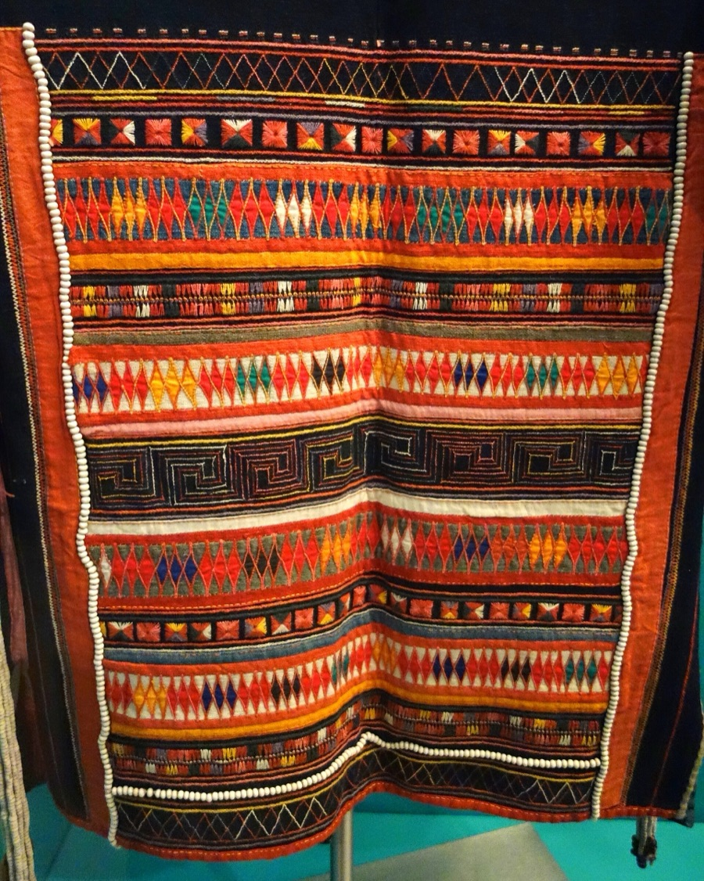
What CCA has
สิ่งที่ CCA มี
91
6
instruments online: Karen, Hmong, Iu Mien. Lahu, Akha and Lisu come next.
peoples since 2005. Films, sound, photos. Hundreds of textiles and instruments.
2023
6 + 2
Akha Oral Tradition School, Ban Saen Suk. The first four years end July 2027.
six directors, two advisers from the communities, three interns.
Akha woman's jacket · Fernbank Museum · Daderot · CC0
Notes:
What CCA already has. Ninety-one instruments online, with photos, sound, who made it and who plays it. Twenty years of recordings from six peoples. A school that has run since 2023. A new board of six, with two advisers from the communities.

Slide 6
Four gaps, and Hongdam's fix for each
สี่ช่องว่าง และทางแก้ของ Hongdam
The culture is alive in the villages and changing. The recordings are what can be lost: twenty years on a few hard drives. Churches with budgets reach the villages every week. CCA reaches them with Victoria's time.
Cool, dry air
Safe copies
Cloth, wood and leather sit in a hot, damp room. Mould and insects come in the rains.
Twenty years of files sit on a few hard drives. Hard drives fail.
Hongdam · This week: a dehumidifier, under ฿10,000. By January: a dry room, the board's ฿50,000–100,000.
Hongdam · Three copies: two drives and a cloud, one outside Chiang Mai. We do this for 56 projects.
Found online
Ways to give
The knowledge is in the villages, not online. Nine instrument names searched: CCA is not in the top ten.
One way, US donors only, 8% fee. Thai donors get no tax deduction.
Hongdam · Fix the titles, labels and credits, as we do for Mot Dang.
Hongdam · The giving desk is live: hongdam.net/for/cca/give/. Add CCA's Thai QR. File the Thai tax listing.
Notes:
Four gaps. The collection sits in a hot, damp room. The files live on a few hard drives. The instrument pages are not found by Google. There is one way to give, for American donors only. Each gap has a fix that Hongdam does every day: a dehumidifier and then a dry room, three copies, titles and credits, the giving desk.

Slide 7
Eleven tasks, by cost
สิบเอ็ดงาน เรียงตามต้นทุน
1 | Donate page names Fractured Atlas, CCA's US charity. Tim, ten minutes. | ฿0
2 | Giving desk live with CCA's Thai QR. Victoria says yes. | ฿0
3 | School page and concerts on Mot Dang, Thai and English. | ฿0
4 | Thai Revenue Department listing, with Beer: Thai donors deduct gifts. | ฿0
5 | Dehumidifier and meter. Textiles and instruments off the floor. | < ฿10,000
6 | Two drives and a cloud account in CCA's name: three copies. | ≈ ฿10,000
7 | Safe copies set up, checked twice a year. | US$700
8 | The British Museum application, drafted. | US$1,000
9 | Village map: tap a village, hear it, open its CCA pages. | US$1,000
10 | 91 instrument pages titled, labelled and credited for Google. | US$1,500
11 | Dry room: air con, dehumidifier, archive boxes. Six gifts of ฿10,000–20,000. | ฿50,000–100,000
Notes:
Eleven tasks, sorted by cost. Four are free and start this month. Two cost under ten thousand baht and start this week. Four are Hongdam's paid work, seven hundred to fifteen hundred dollars each, half payable in kind. One, the dry room, is the board's gift together.

Slide 8
November to July
พฤศจิกายนถึงกรกฎาคม
November
December
January
2027
This week
1 Dec
Jan
Feb
Dehumidifier. Two drives. Donate page wording.
Grant in, before 19:00 Thai time.
The dry room, the board's gift.
A sponsor page for the school's next four years.
24 Nov
Early Dec
15 Jan
Spring
Grant draft to the board.
Lahu, Akha and Lisu instruments online.
Firebird grant: Akha oral literature.
UCLA grant for the recordings and films, up to US$100,000.
30 Nov
Dec
31 Jan
Jul
Every director has given money or brought a donor.
Sponsor evening at Melodies and Motifs, before it closes 10 Jan.
A treasurer, two giving seats, one page of numbers.
First four years end; the next four funded before they start.
Notes:
The calendar. This week the dehumidifier and the drives. 24 November the grant draft. 30 November every director has given or brought a donor. 1 December the grant goes in. The sponsor evening in December at the exhibit. January: the dry room, the Firebird grant, a treasurer and one page of numbers. Then the school's next four years.

Slide 9
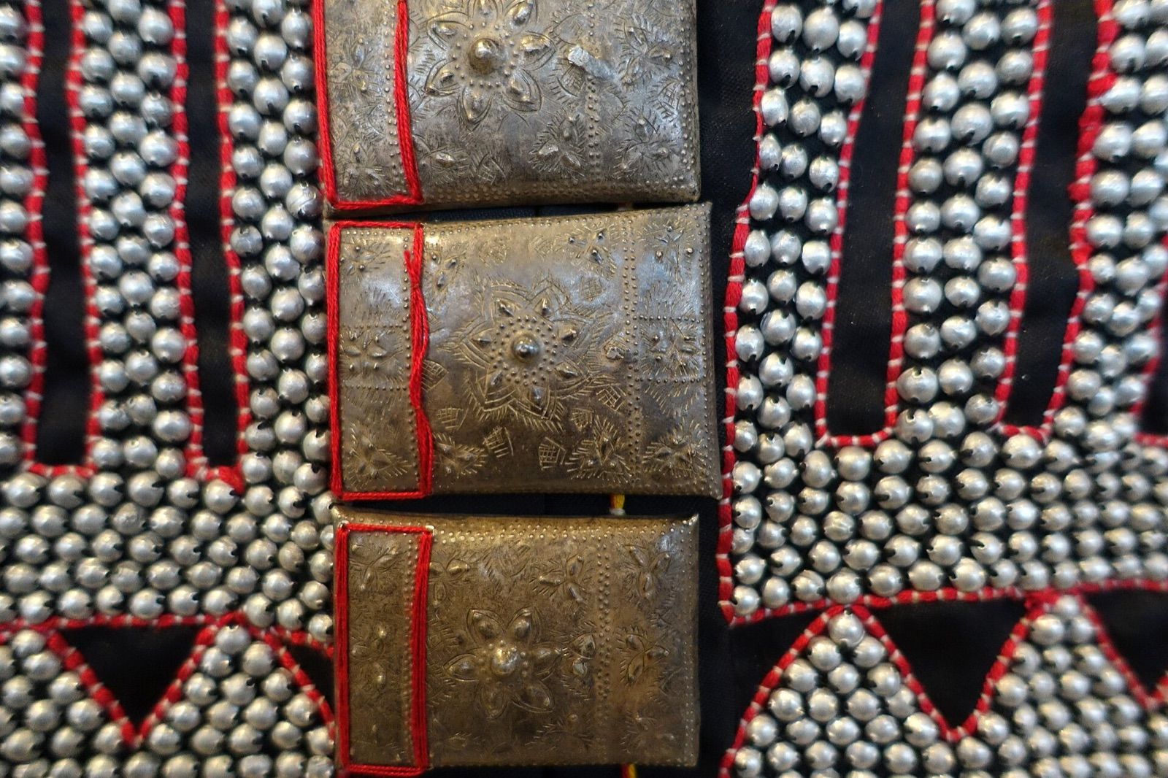
Give money, get donors, or leave the seat
GIVE, GET, OR STEP ASIDE
68%
of nonprofits ask every board member for a yearly gift. On American boards every director gives each year, and American donors ask about this first. (BoardSource)
Six seats. Each director gives ฿10,000 or ฿20,000, or brings three donors: a sponsor, a venue, a company. In the picture: three give, one brings donors, two have not decided.
ให้เงิน หาผู้บริจาค หรือสละที่นั่ง
Hongdam works free while every non-indigenous director gives money or brings donors. Indigenous members and the Ethnic Advisory Council: we ask for advice, not money.
Lahu woman's jacket, 1986 · Berlin · Daderot · CC0
Notes:
Give, get, or step aside. In the United States, 68 percent of nonprofits require every board member to give each year, and donors ask about it first. Six seats here: each gives ten or twenty thousand baht, or brings three donors. Six gifts build the dry room. Hongdam's free work runs while every non-indigenous director gives or brings donors. Indigenous members and the Ethnic Advisory Council are asked for advice, not money.

Slide 10
Decisions today
ข้อตัดสินใจวันนี้
British Museum grant: host, lead, grant and writer named today. Draft 24 November. In by 1 December.
Every non-indigenous director gives money or brings a donor by 30 November.
The board pays for the dry room together, ฿50,000–100,000, by January.
Victoria: CCA's Thai QR goes on the giving desk. The donate page names Fractured Atlas.
A treasurer, two giving seats and one page of numbers by 31 January.
Buy the four services at Thai-friendly rates. Work starts when payment arrives.
Questions and decisions by email: nan@motdang.net
Notes:
Six decisions. The grant: name the host, the lead, the grant and the writer today. Every non-indigenous director gives or brings a donor by 30 November. The board funds the dry room together. Victoria: the Thai QR and the donate page wording. A treasurer and one page of numbers by the end of January. And the four services. Decisions by email to NaN.

Slide 11
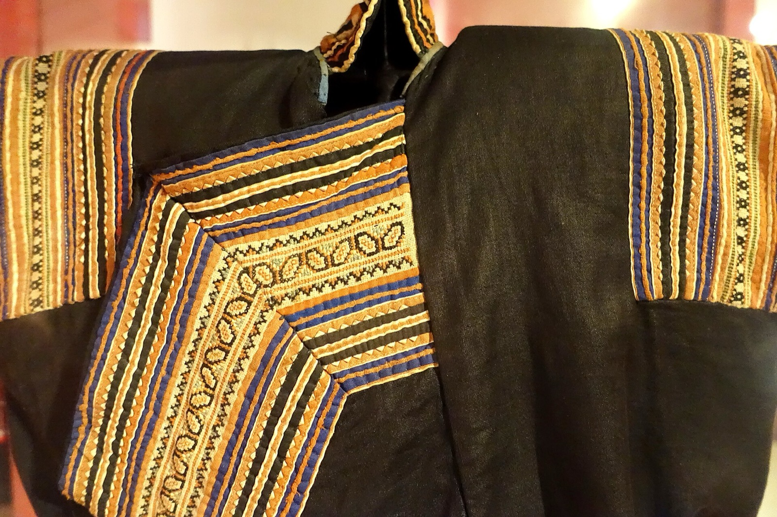
Four essential services, at Thai-friendly rates
บริการจำเป็นสี่อย่าง ในราคาที่เป็นมิตรกับไทย: ตั้งราคาสำหรับมูลนิธิไทย จ่ายครึ่งหนึ่งเป็นสิ่งของได้ งานเริ่มเมื่อได้รับเงิน
Priced for a Thai foundation, half payable in kind. Work starts when payment arrives. Accepted by Victoria on 5 November.
Safe copies
British Museum application draft
Village map
91 instruments found online
US$700
US$1,000
US$1,000
US$1,500
Three copies of the archive, two drives and a cloud, one outside Chiang Mai. A file list with a fingerprint per file, checked twice a year.
Akha instrument-making with the master makers, plus Legacy Digitisation. Draft to the board 24 Nov, in the portal by 1 Dec.
Tap a village, hear its recordings, see its instruments and players, open each CCA page. English and Thai, on CCA's website.
Every page titled, labelled and credited so Google finds it. CCA's name inside every file. A Sponsor button on each page.
Buy · nan@motdang.net
Buy · nan@motdang.net
Buy · nan@motdang.net
Buy · nan@motdang.net
Free, from Hongdam: this brief, the giving desk, the school's page on Mot Dang, and Beer's help with the Revenue Department listing.
Hmong Den costume detail, 1950 · Vietnamese Women's Museum · Daderot · CC0
Notes:
Four services at Thai-friendly rates: priced for a Thai foundation, half payable in kind, and work starts when payment arrives. Safe copies, seven hundred dollars. The British Museum draft, a thousand. The village map, a thousand. The ninety-one instruments found online, fifteen hundred. The British Museum draft is the one to order this week, to make 24 November. Email NaN to order.

Slide 12
Twenty years of work deserve a long life
งานยี่สิบปีสมกับอายุที่ยืนยาว
hongdam.net/for/cca/
The brief, in English and Thai
hongdam.net/for/cca/board/
The interactive deck
hongdam.net/for/cca/give/
The giving desk
emkp.org/documentation-grants/
The British Museum grant
culturalcrossroadsasia.org/instruments-by-ethnic-group/
The 91 instruments
nan@motdang.net
NaN, Hongdam, Chiang Rai. Questions and orders by email.
Notes:
Everything is at hongdam.net/for/cca/, with the interactive deck and the giving desk. Questions and orders go to NaN by email.

Slide 13
Photographs and sources
ภาพถ่ายและที่มา
Photographs
Sources
Two Lahu men play pan flutes, Thailand · Steve Jurvetson · CC BY 2.0 · Wikimedia Commons
Akha woman's clothing, 20th century · Fernbank Museum · Daderot · CC0 · Wikimedia Commons
Lahu woman's jacket, northern Thailand, collected 1986 · Ethnological Museum, Berlin · Daderot · CC0 · Wikimedia Commons
Hmong Den costume detail, Hoa Binh, 1950 · Vietnamese Women's Museum, Hanoi · Daderot · CC0 · Wikimedia Commons
culturalcrossroadsasia.org, 9 Nov 2026: 91 collection entries (Karen 45, Hmong 23, Iu Mien 22, Kayaw 1); search of nine instrument names, 23 Oct 2026.
emkp.org: Documentation grants, Legacy Digitisation grants and FAQs, read 9 Nov 2026. Deadline 1 Dec 2026, 12:00 GMT. GBP to THB 44.98, x-rates.com, 9 Nov 2026.
BoardSource, "Board Members' Personal Contributions", via Bridgespan: 68% of nonprofits require a yearly board gift.
Fiscal Sponsor Directory: Fractured Atlas, 8% fee, US$20,000 online cap. Forvis Mazars Thailand, Aug 2026: e-Donation.
Hongdam, plan sent to the CCA board 29 Oct 2026, and this brief, 9 Nov 2026. Prepared by Hongdam, Chiang Rai.
Notes:
Photo credits and sources, for the record.

